Slide 1

Sclerosis Detection in MRI data using Deep Learning
Guide: Prof NIVITHA K
21BCT0108 - Aditya Raj Prasad
21BCT0163 - Vedant Sharma
21BDS0096 - Atharva Prashant Khadse

Slide 2

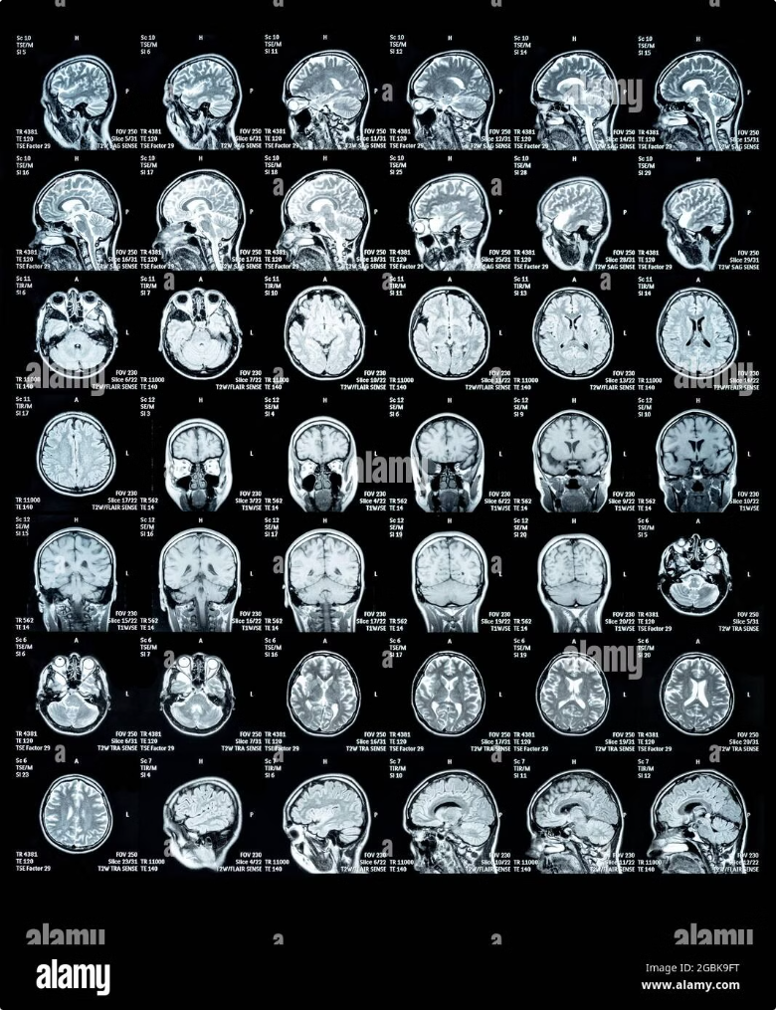
Abstract
This project utilizes deep learning, specifically FCN, for automated sclerosis detection in MRI scans. It enhances diagnostic accuracy by segmenting affected regions while addressing challenges like data imbalance and scan variability. The study highlights AI's potential to improve clinical workflows and patient outcomes.
1
Purpose
2
Methodology
To develop an AI-driven system using deep learning for automated sclerosis detection in MRI scans, improving diagnostic accuracy and efficiency.
Utilizes FCN for image segmentation, with data preprocessing, augmentation, and transfer learning to handle dataset imbalances and scan variations.
3
Impact
Enhances diagnostic workflows, reduces manual effort, and improves patient outcomes, paving the way for AI-driven medical imaging advancements.

Slide 3
Literature Review
s.no
Paper Title
Author(s)
Publish year
Model Used
Deep
Summary
Limitation
Learning
Architecture
1
A Bibliography of Multiple Sclerosis Lesions Detection Methods Using Brain MRIs
Atif Shah, Meged S,AI-Shaibani, Moataz, Ahmad ,Reem Bunyan
2023
CNN-based
Deep CNN
Reviews applications of deep learning in MS detection, including CNN models for lesion segmentation and classification.
Limited focus on real-world clinical implementation and dataset generalization
architectures
2
Multiple Sclerosis Lesion Analysis in Brain Magnetic Resonance Images: Techniques and Clinical Applications
Yang Ma,
2021
Statistical &deep learning methods
Hybrid of CNN and statistic methods
Reviews segmentation techniques for MS lesion detection, highlighting advantages of deep learning models.
Lacks extensive benchmark comparisons across multiple datasets.
Chaoyi
Zhang,
Mariano
Cabezas, et
al.
3
Self-Adaptive 2D- 3D Ensemble of Fully Convolutional Networks for Medical Image Segmentation .
Maria G.
2019
Self-adaptive FCN ensemble
Combination of 2D and 3D FCN
Proposes an ensemble model that integrates both 2D and 3D information for improved segmentation accuracy.
Computationally expensive and requires significant memory resources.
Baldeon
Calisto,
Susana K.
Lai-Yuen

Slide 4
s.no
Paper Title
Author(s)
Publish year
Model Used
Deep
Summary
Limitation
Learning
Architecture
4
Uncovering Convolutional Neural Network Decisions for Diagnosing Multiple Sclerosis on Conventional MRI Using Layer-Wise Relevance Propagation
Fabian Eitel, Emily Soehler, Judith Bellmann-Strobl, etal.
2019
CNN with Layer Wise Relevanec Propagation (LRP)
Deep CNN
Introduces an explainable AI technique to visualize CNN decisions for MS detection.
Limited interpretability for highly complex cases and small dataset size.
5
Automated Detection of Multiple Sclerosis Lesions Using Convolutional Neural Networks with Transfer Learning
Niloofar Yousefi,Mohamed Seera, Chee Peng Lim
2020
CNN with transfer learning
VGG16,
Uses pre-trained CNN models for lesion detection and classification in MS MRI scans
Dataset imbalance affects model performance.
ResNet50
6
3D Deep Learning Approach for Multiple Sclerosis Lesion Segmentation Using MRI Data
AnnaDyrba, Stefan Oltmanns,Mirco Riedel, et al.
2020
3D U-Net
3D CNN (U-
Develops a 3D U-Net model for precise segmentation ofMS lesions.
Requires large labeled datasets for training.
Net variant)

Slide 5
S.no
Paper Title
Author(s)
Publish year
Model Used
Deep
Summary
Limitati-on
Learning
Architecture
7
Multi-Scale Attention U-Net for Multiple Sclerosis Lesion Segmentation
Sarah Rezaei, Hooman Bahrami,Mohammad Fakhri
2021
Attention U-
U-Net with
Enhances lesion segmentati-on accuracy using attention layers.
Computati-nal cost is high due to complex attention mechanism.
Net
attention
mechanis-ms
8
Hybrid Deep Learning Model for MS Detection Using MRI and Clinical Data
Lianqiang Gao, Wei Zhang, Xin Li
2022
Hybrid CNN-RNN model
Combinati-on of CNN and LSTM
Integrates imaging and non-imaging data for better MS detection.
Requires multi-modal datasets, which are scarce.
9
Deep Reinforcement Learning for Automated MS Lesion Segmentation
Alex johnson,Maria Perez,Kevin Lee
2022
Deep Reinforce-ment Learning (DRL)
Combinati-on of CNN and reinforcem-ent learning
Uses an agent-based approach to refine lesion segmentati-on iteratively.
Training is complex and computati-onally intensive.
10
Transformer-Based Deep Learning Model for MS Diagnosis from MRI Scans
Roberto Hernandez,Julia Wong,Eric Brown
2023
Vision Transformer(ViT)
Transformerbased model
Applies self-attention mechanis-ms to MRI data for MS classificati-on.
Requires large-scale labeled MRI datasets for optimal performan-ce.

Slide 6
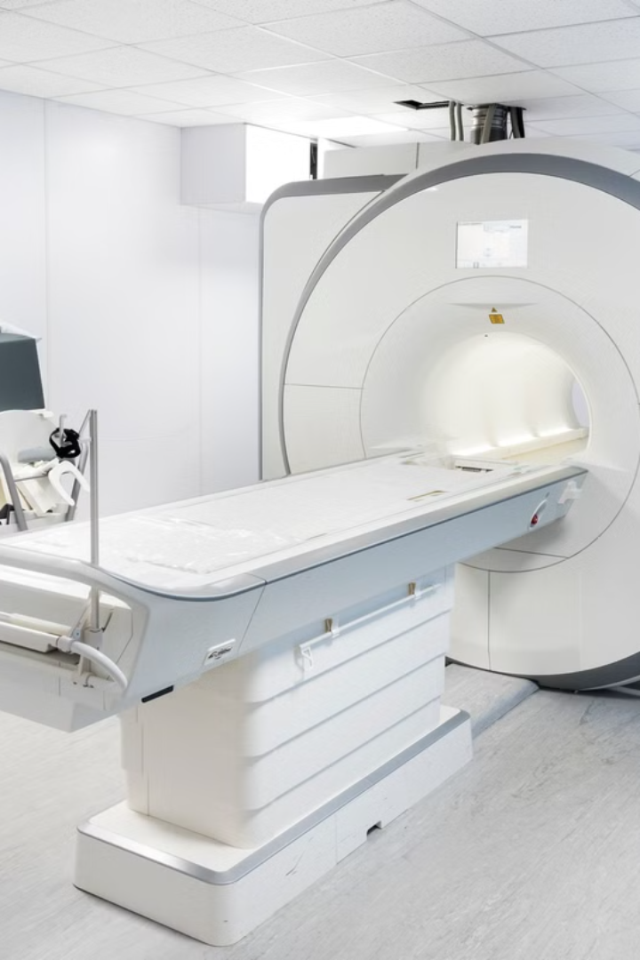
Research Gap
While existing studies have established the feasibility of using DL for sclerosis detection, key gaps remain:
Annotated Data:
1
Many studies rely on small, domain-specific datasets, limiting the generalizability of models to diverse patient populations.
2
Model Robustness:
Current models often struggle with variations in MRI imaging protocols, noise.
Interoperability Concerns:
3
The challenges that arise when different AI systems, models, or platforms cannot effectively communicate or work together.
4
Integration into Clinical Practice:
Limited work has been done to bridge the gap between research models and deployable systems that can be seamlessly integrated into clinical workflows.

Slide 7


Objectives
This research aims to address the identified research gaps by developing an innovative AI-powered detection system.
1
Develop a robust deep learning framework for sclerosis detection using Fully Convolutional Networks (FCNs)
2
Generate binary mask using trained model.
3
Highlight the detected lesions and super impose them on original MRI image.
4
Enhance model robustness to imaging variations and noise.
5
Determining severity of disease by estimating the area occupied by lesions.

Slide 8






Project Plan
The project will be structured in a sequential manner, encompassing distinct phases.
Phase 1: Data Collection and Preprocessing
Acquire publicly available and clinical MRI datasets of sclerosis patients.Preprocess the data to normalize image quality and address noise, variations,and artifacts
Phase 2: Model Development
Implement Fully Convolutional Networks (FCNs) for segmentation and feature extraction. Employ data augmentation, transfer learning, and GAN-based synthetic data generation to address data scarcity.
Phase 3: Model Evaluation and Optimization
Evaluate the models using performance metrics such as accuracy, sensitivity, specificity.Optimize models to enhance robustness against variations in MRI scans and reduce false positives/negatives.
Phase 4: Interpretability and Validation
Integrate interpretability techniques to visualize model predictions.
Validate the framework on unseen clinical datasets to assess real-world
applicability.

Slide 9
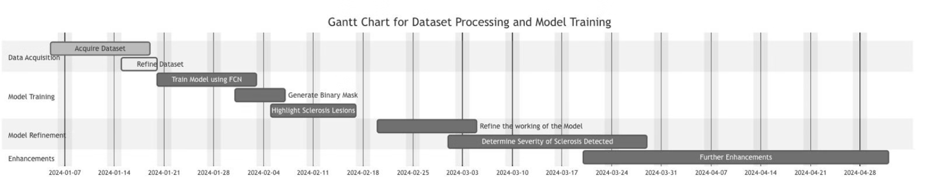
Activity Chart with Milestones

Slide 10
Sustainable Development Goals
Sustainable Development Goal 3- Good Health And Well being Reduced Healthcare Burden:
Automating the detection process helps in reducing the workload on radiologists and ensures accessibility of expert-level diagnosis even in under-resourced settings.
Promotion of AI in Health Innovations:
Aligns with Target 3.D: Strengthen the capacity of all countries, particularly developing countries, for early warning, risk reduction, and management of national and global health risks. Sustainable Development Goals 7 Affordable and Clean Energy Optimized Resource Utilization:
Deep learning models can be integrated into edge devices or cloud systems that run efficiently.
Centralized vs. Decentralized Computation:
With cloud-based solutions, hospitals can share AI models instead of installing expensive local servers, leading to shared computational resources and less total energy usage.
Notes:
Automated detection helps reduce radiologists' workload and ensures expert-level diagnosis in under-resourced areas Aligns with WHO's goal to strengthen capacity for early warning, risk reduction, and health risk management in developing countries Deep learning models can run efficiently on edge devices or cloud systems, optimizing resource utilization Cloud-based solutions allow hospitals to share AI models instead of installing expensive local servers, reducing total energy usage through shared computational resources

Slide 11


Analysis and Requirements
Neurological disorders like Multiple Sclerosis (MS) require precise and early diagnosis to prevent severe health deterioration. Traditional manual analysis of MRI scans by radiologists is time-consuming, subjective, and prone to errors. An AI-powered sclerosis detection system using Fully Convolutional Networks (FCNs) can automate the identification and segmentation of sclerosis-affected regions, improving diagnostic accuracy and efficiency.
1. Data Collection and Management
Requirement: The system must access diverse MRI datasets with annotated sclerosis regions for model training and evaluation.
Considerations: Datasets should include MRI modalities (FLAIR) and account for variations in scanner types, resolutions, and patient demographics.
2. Model Training and Development
Requirement: The system must train an FCN-based deep learning model to detect sclerosis lesions from MRI scans.
Considerations: Efficient hyperparameter tuning (batch size, learning rate, epochs) and GPU acceleration for faster training. Data augmentation (rotation, intensity scaling) to improve model generalization and prevent overfitting.

Slide 12


3. Sclerosis Detection on MRI Scans
Requirement: The system must analyze MRI scans, detect sclerosis lesions, and highlight affected regions.
Considerations: Accurate segmentation with minimal false positives/negatives. Support for different MRI slice orientations.
4. Lesion Segmentation and Quantification
Requirement: The model should outline sclerosis lesions with segmentation masks and quantify their size and distribution.
Considerations: High-precision lesion boundaries to differentiate sclerosis from artifacts. Dynamic thresholding techniques for varying intensity levels in MRI images.

Slide 13
5. User Interface and Interaction
Requirement: The system must provide a user-friendly interface for radiologists to upload MRI scans, visualize results, and review diagnostic reports.
Considerations: Intuitive navigation, interactive lesion visualization, and options for exporting results (PDF format).
6. Deployment and Maintenance
Requirement: The system must support model updates and continuous learning with new MRI data to enhance accuracy.
Considerations: Regular updates using federated learning or incremental retraining. Periodic model validation to maintain reliability in clinical settings.

Slide 14
SYSTEM SPECIFICATION
The hardware requirements for the sclerosis detection system are categorized into development and deployment environments. In the development environment, the system needs a CPU such as Intel Core i5/i7 or AMD Ryzen 5/7, with at least 8GB of RAM . A dedicated GPU, like the NVIDIA RTX 1650 or higher with 6GB VRAM, is essential, though Tesla V100 or A100 is preferred for production-level training.
Storage includes a 1TB SSD for development and over 5TB for dataset storage and model checkpoints, along with a high-speed internet connection for cloud integration. In the deployment environment, server-grade processors like Intel Xeon or AMD EPYC are required, along with a minimum of 4GB of RAM. For inference, an NVIDIA GTX 1650 and storage consists of a 500GB SSD for the application and 512GB for database and image storage, with a Gigabit Ethernet connection to integrate with hospital PACS systems. On the software side, the system operates on Windows 10/11 and is developed using Python 3.12. It utilizes deep learning frameworks such as TensorFlow 2.17, Keras, and PyTorch. For data processing, libraries like NumPy, Pandas, SciPy, and scikit-learn are employed, while OpenCV, SimpleITK, and Nibabel handle medical image processing. Development is done using PyCharm IDE, providing an efficient environment for coding and testing the system

Slide 15
System Design
The proposed system will be designed as a modular architecture, comprising distinct components.
MRI Data
Image Preprocessing
Sclerosis Detection Model
Result Visualization and Reporting
Acquisition
Enhance MRI image quality by normalizing intensity levels, removing noise, and correcting artifacts. Apply contrast adjustments and segmentation preprocessing to improve lesion detection accuracy.
Implement a deep learning model, Fully Convolutional Network (FCN) to detect and segment sclerosis-affected regions. Train the model on annotated MRI datasets to accurately distinguish lesions from normal brain tissue.
Acquire MRI scans from clinical sources, including hospitals, research institutions, and publicly available medical datasets. Ensure compatibility with MRI modalities (FLAIR) for comprehensive analysis.
Overlay detected sclerosis lesions on the original MRI scans for better interpretability. Provide detailed diagnostic reports with lesion size, location, and severity assessment. Allow clinicians to export results in PDF for further analysis.
Design Overview
The sclerosis detection system is designed to identify and segment sclerosis-affected regions in MRI scans using deep learning, specifically Fully Convolutional Networks (FCN) The system ensures accurate and efficient diagnosis while handling variations in MRI scan parameters and quality.
Key Components:
MRI Data Input Pipeline: Supports both clinical MRI datasets and real-time scan uploads.
Preprocessing Module: Performs intensity normalization, noise reduction, and artifact correction to enhance image quality.
FCN-Based Model: Uses FCN architecture for automated sclerosis lesion segmentation.
Post-Processing: Refines segmentation results, highlights detected regions, and overlays them on the MRI scan.
User Interface: Enables clinicians to upload scans, visualize AI-generated lesion maps, and interact with diagnostic insights.
Deployment: Optimized for cloud-based or edge deployment, ensuring efficient processing in medical applications.

Slide 16
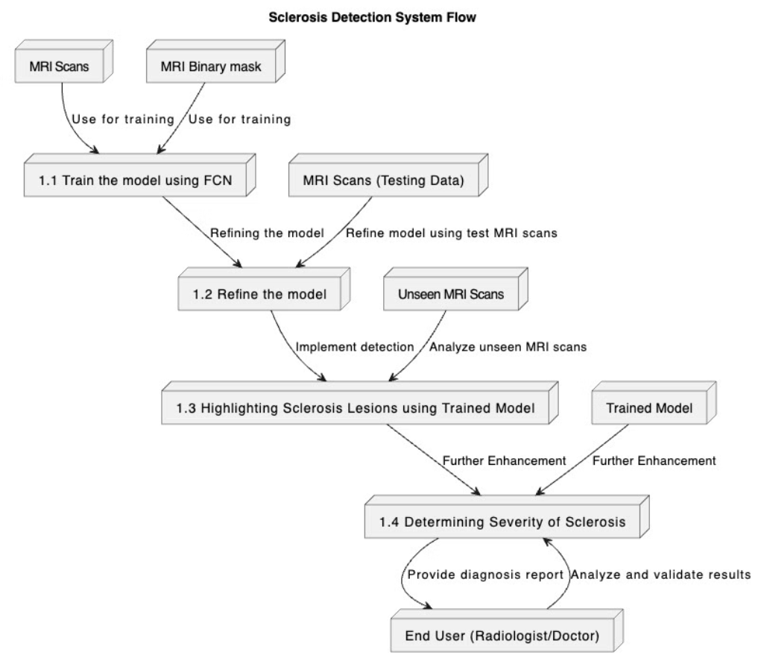

Slide 17
Design Standards and Best Practices
Industry Standards
IEEE Standards for AI in Medical Imaging:
IEEE 1012: Ensures verification and validation processes for accurate MRI-based sclerosis detection.
IEEE 829: Establishes standardized documentation for testing and deployment of the AI model.
ISO Certifications for Healthcare AI:
ISO 13485: Ensures quality management for medical AI applications.
ISO/IEC 27001: Guarantees secure handling of sensitive patient MRI data.
Benchmarking: The model should be regularly evaluated against established industry metrics for accuracy, reliability, and compliance with healthcare AI standards.
Model Design Best Practices
Transfer Learning: Fine-tune pre-trained FCN models on MRI datasets to enhance segmentation accuracy and reduce training time.
Cross-Validation: Implement k-fold cross-validation to improve model generalization across different sclerosis cases.
Continuous Model Evaluation: Deploy an ongoing evaluation pipeline to monitor model performance post-deployment and retrain using new clinical data.

Slide 18


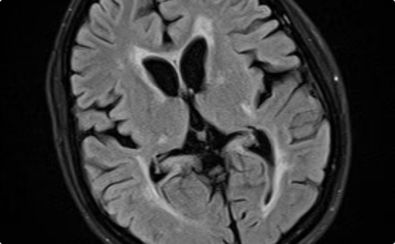
Implementation and Evaluation
The proposed AI-powered detection system will be implemented and evaluated using a comprehensive methodology.
Model Training
Performance Evaluation
Detection
Train the deep learning model using the annotated MRI dataset.
Evaluate the model's accuracy, precision, recall, and F1-score on test datasets.
MRI lesion detection is done using the trained model.

Slide 19
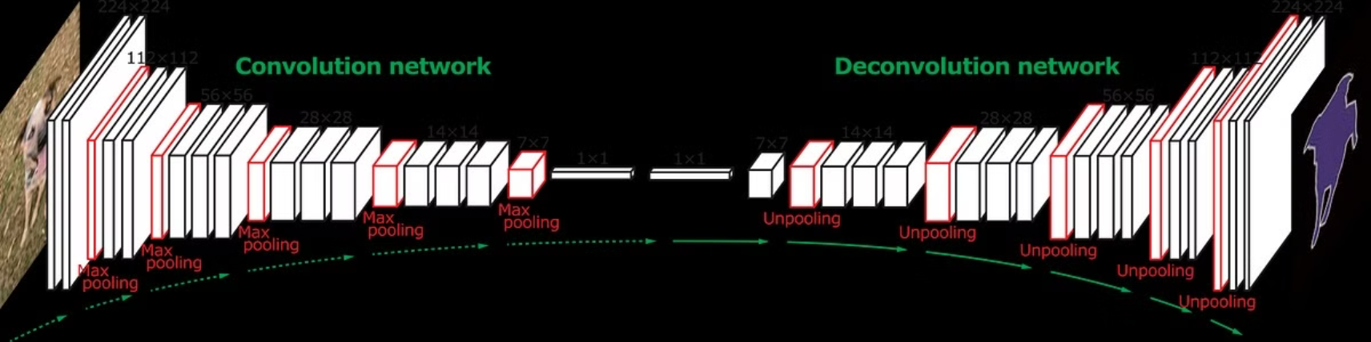
FCN Architecture

Slide 20
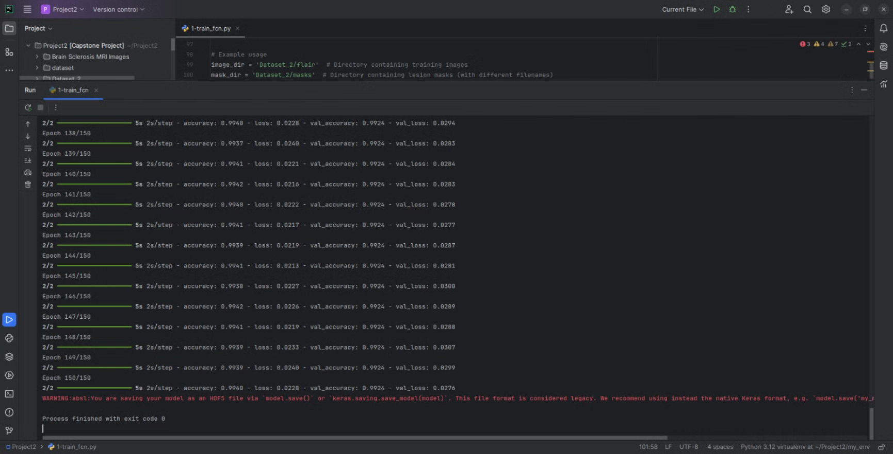
Model Training

Slide 21
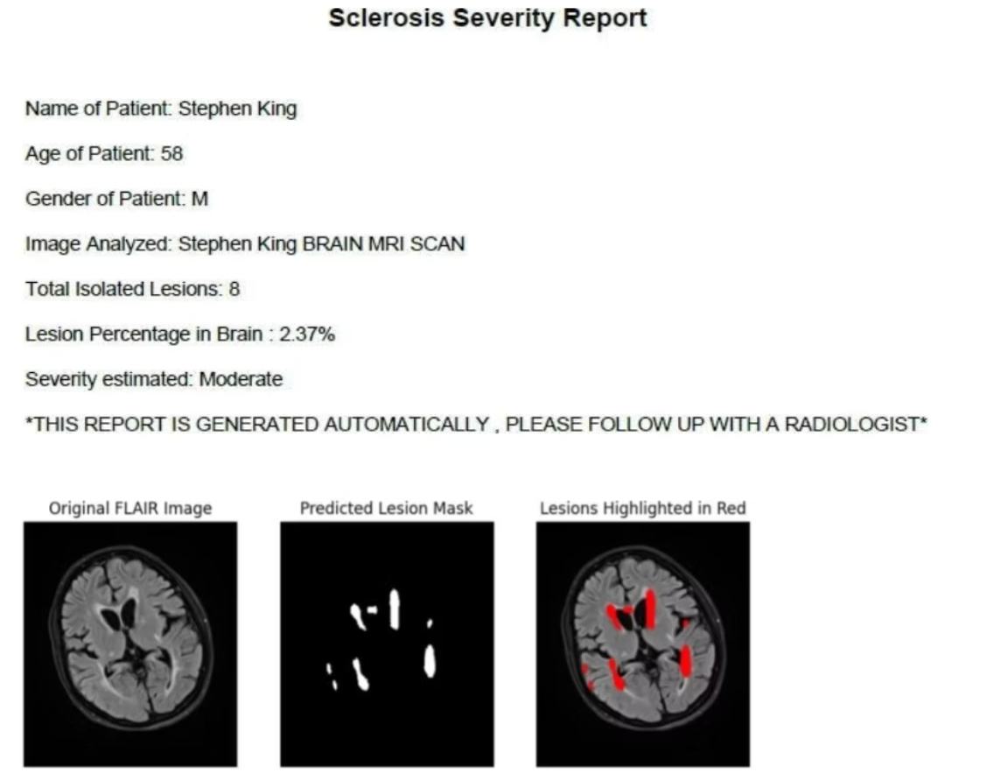
Result

Slide 22
Result Analysis
1
The project demonstration bridges theory and practice by showcasing the real-world effectiveness of a deep learning-based system for sclerosis detection. It highlights key features such as MRI scan input, lesion detection using a trained Fully Convolutional Network (FCN), binary mask generation, and lesion visualization through image overlay. A standout feature is the automated PDF report generation, which enhances clinical utility.
2
The system preprocesses MRI scans, runs them through an FCN trained over 100 epochs, and highlights predicted lesions in red using OpenCV. It then analyzes lesions to determine count, area, and severity, categorizing them into four levels: Low, Moderate, High, and Severe.
3
All findings—including patient details, lesion metrics, severity classification, and annotated images—are compiled into a structured PDF report. This report supports clinicians with quick, clear, and actionable insights for accurate and timely diagnosis.

Slide 23
Contribution of individual Team members
Aditya Raj Prasad (21BCT0108) As part of this project, I contributed to framing the problem statement, defining the research objectives, and identifying the research gap during the initial phases. I was responsible for designing the system architecture diagrams, including both the Data Flow Diagram and the Class Diagram, which clearly visualized the structure and workflow of our proposed solution. Additionally, I played an active role in drafting the IEEE journal and conference abstracts, helping articulate the core methodology and key experimental outcomes of our work. I also created the project presentation and poster, and contributed to the final documentation and project demonstration.
Vedant Sharma (21BCT0163) In this project, I led the design and implementation of the deep learning model using Fully Convolutional Networks (FCNs), focusing on accurate sclerosis lesion detection and segmentation from MRI data. I developed the visualization module using OpenCV, which allowed us to overlay detected lesion areas on MRI scans and enhance interpretability. I was also responsible for evaluating the model’s performance using metrics such as Dice Similarity Coefficient (DSC), Precision, Recall, and AUC, ensuring the system’s effectiveness across different test cases. Additionally, I contributed to report writing and research paper development, documenting our methodology and findings.
Atharva Prashant Khadse (21BDS0096) My primary contribution to the project involved hyperparameter tuning, where I focused on improving the model's accuracy and generalization by experimenting with various configurations such as learning rates, dropout strategies, and regularization techniques. I was also responsible for dataset curation, which included acquiring both publicly available MRI datasets and anonymized clinical data, and ensuring high image quality through preprocessing and normalization. Additionally, I implemented a range of data augmentation techniques—including image rotation, flipping, and noise addition—to enrich the dataset and enhance the model’s robustness. Beyond the technical aspects, I contributed significantly to the project report, assisted with technical documentation and result analysis, and co-authored the research paper summarizing our findings and methodology.

Slide 24
Impact of the project on society and environment
The proposed deep learning-based system for sclerosis detection has significant societal and environmental impact. By enabling early and accurate identification of sclerosis through automated MRI analysis, it enhances diagnostic efficiency and supports timely medical intervention. This can lead to improved patient outcomes, reduced disease progression, and a better quality of life for individuals affected by neurological conditions.
From a societal perspective, the system reduces the workload on radiologists and healthcare professionals, especially in regions with limited access to specialists. It democratizes advanced medical diagnostics by making them more accessible, consistent, and scalable. The automated report generation feature also helps bridge the gap between medical imaging and clinical decision-making, empowering both doctors and patients with clear and structured information.
Environmentally, the digital nature of this system minimizes the reliance on paper-based diagnostics and reduces the need for repeated imaging procedures, thereby saving resources and lowering the carbon footprint associated with hospital operations. By promoting efficient use of medical imaging infrastructure, the project contributes to more sustainable healthcare practices.

Slide 25
Reference
"Multiple Sclerosis Lesion Segmentation: A Survey of Supervised CNN-Based Methods"Huahong Zhang, Ipek Oguz (2020)The paper surveys supervised CNN-based methods for MS lesion segmentation, analyzing their strengths and weaknesses.
"Deep Learning Approaches for Multiple Sclerosis Detection in MRI Images" (2021)This study explores the use of deep learning models to automate MS lesion detection in MRI images, utilizing four convolutional neural network architectures—AlexNet, VGG16 pre-trained on ImageNet, ResNet-10, and DenseNet-121—with modifications to optimize performance for medical imaging tasks.​
"Deep Learning-Based Automated Detection of Multiple Sclerosis Lesions in MRI"( 2021)This study presents an automated DL approach for detecting MS lesions in MRI scans, aiming to improve diagnostic efficiency.
"Detection of Multiple Sclerosis using Deep Learning"(2021)This study proposes efficient multiple sclerosis detection techniques to improve the performance of detecting white matter lesions in 3D magnetic resonance images (MRIs) of patients with multiple sclerosis.
"Multiple Sclerosis Diagnosis Using Machine Learning and Deep Learning: Challenges and Opportunities" This paper discusses the use of machine learning and deep learning methods in diagnosing multiple sclerosis through MRI, highlighting the challenges and opportunities in this field.
"Applications of Deep Learning Techniques for Automated Multiple Sclerosis Detection Using Magnetic Resonance Imaging: A Review" Authors: Afshin Shoeibi, Marjane Khodatars, Mahboobeh Jafari, et al.( 2021)This review discusses the application of deep learning techniques on MRI data for the diagnosis and monitoring of multiple sclerosis, highlighting various methods and their effectiveness.​
"Multiple Sclerosis Cortical Lesion Detection with Deep Learning at Ultra-High-Field MRI"Francesco La Rosa, Erin S. Beck, Josefina Maranzano, et al.The study presents a deep learning approach for detecting cortical lesions in multiple sclerosis patients using ultra-high-field MRI data.
"4D Deep Learning for Multiple Sclerosis Lesion Activity Segmentation" Authors: Nils Gessert, Marcel Bengs, Julia Krüger, et al. ( 2020) The study investigates a recurrent multi-encoder-decoder architecture for processing 4D data to improve performance in multiple sclerosis lesion activity segmentation.​

Slide 26
"Uncovering Convolutional Neural Network Decisions for Diagnosing Multiple Sclerosis on Conventional MRI Using Layer-Wise Relevance Propagation"Authors: Fabian Eitel, Emily Soehler, Judith Bellmann-Strobl, et al.(2019) This study presents a transparent deep learning framework relying on convolutional neural networks and layer-wise relevance propagation for diagnosing multiple sclerosis, aiming to uncover relevant image features used for decision-making.​
"An Explainable AI Model in the Assessment of Multiple Sclerosis Using Clinical Data and Brain MRI Lesion Texture Features"The study proposes an explainable artificial intelligence model that integrates clinical data and brain MRI lesion texture features to assess multiple sclerosis.
"Deep Learning-Based Multiple Sclerosis Lesion Segmentation in MRI: A Comparative Study" (2020) This study compares various deep learning architectures for the task of multiple sclerosis lesion segmentation in MRI, evaluating their performance and robustness.
"Deep Learning for Multiple Sclerosis Lesion Detection and Segmentation in MRI: A Review" (2020)This review provides an overview of deep learning methods applied to the detection and segmentation of multiple sclerosis lesions in MRI, discussing various architectures and their performance.
"Multiple Sclerosis Diagnosis Using Machine Learning and Deep Learning: A Review" (2022)This review discusses various machine learning and deep learning approaches for diagnosing multiple sclerosis, focusing on their application to MRI data.
"Automated Detection of Multiple Sclerosis Lesions in MRI Using Deep Learning" ( 2021) The paper proposes a deep learning-based approach for the automated detection of multiple sclerosis lesions in MRI, utilizing a convolutional neural network trained on annotated datasets.

